Slide 1
Build unique GenAI experiences that scale with your data

Slide 2
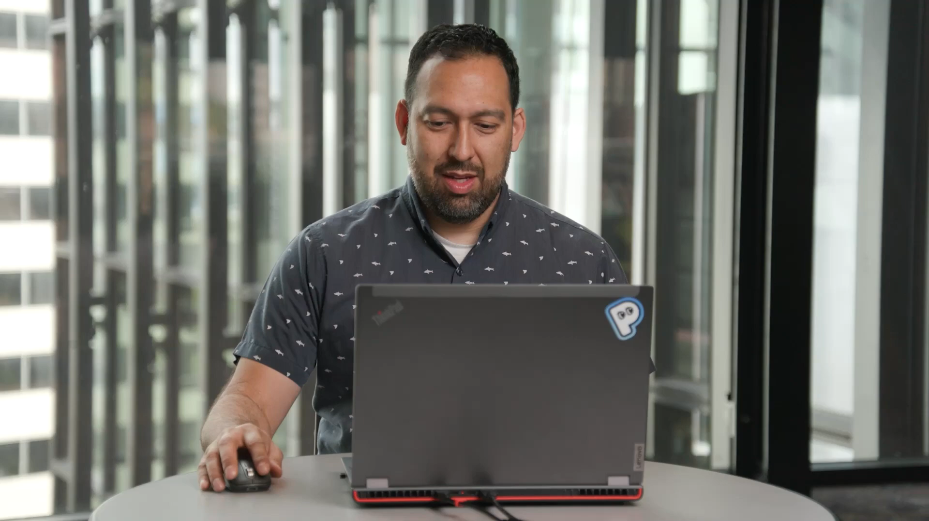
Build your own copilot

Slide 3
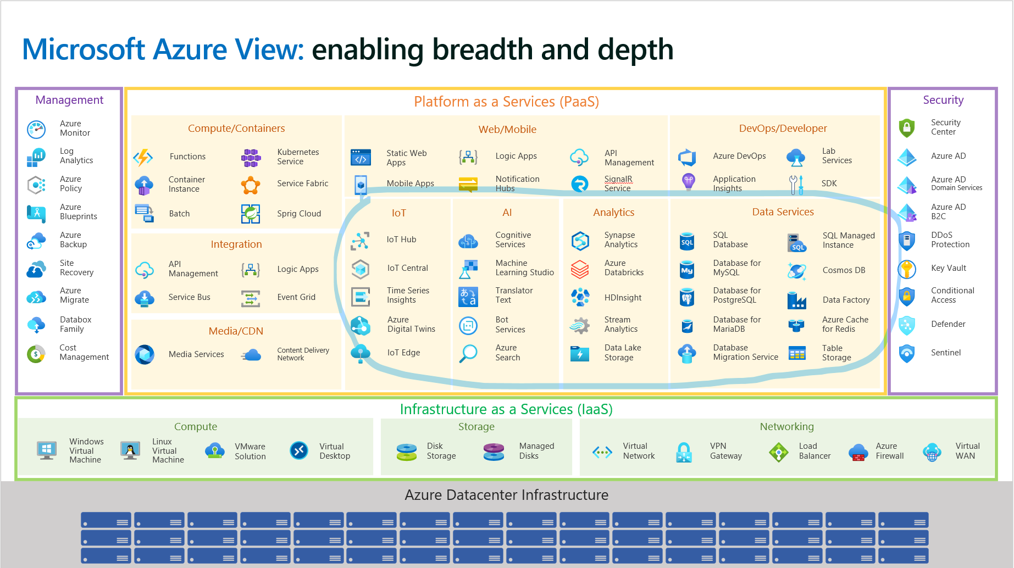
outdated

Slide 4
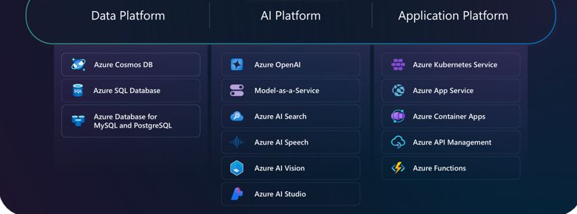

Slide 5

Generative AI is the greatest force multiplier we’ve ever had at our fingertips
New automation
efficiencies
New
customer
engagements
GenAI
New
personal
productivity
New
products
& services

Slide 6
60,000+ organizations
are innovating and scaling with the
Azure AI platform
Rockwell Automation
H&R
Block
Bosch
NBA
New
automation
efficiencies
New
customer
engagement
Volvo
ASOS
Sweco
CarMax
Unity Gaming
H&M
Siemens
Honeywell
Freshworks
Mercedes-Benz
New
personal
productivity
New
products
& services
Heineken
Unilever
KPMG
Tom Tom
PricewaterhouseCoopers
Coca-Cola

Slide 7
Unlock any use case with Azure AI
Sio
Automation
Customer engagement
Personal productivity
Products & services
Top Use Cases
Design
Training
eCommerce
Learning
Writing
Self-service
Call Centers
Ideation
Coding
Personalization
AI Capabilities
Reporting
Advertising
Q&A
Translation
Inventory
Recommendations
Materials
Multimodality
Maintenance
Transcription
Insights
Safety
Summarization
Robotics
Detection
Optimization
Sourcing
Chat
Sentiment
Perception
Forecasting
Supply Chain
Procurement
Monitoring
Inspection
Azure AI
Platform
Transactions
Authentication
Simulation
Prototyping

Slide 8


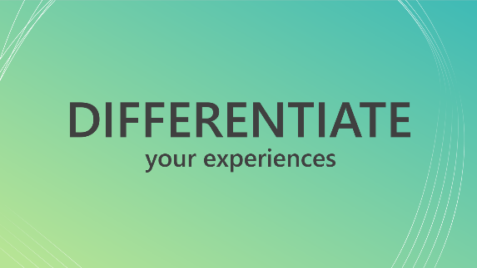

Let’s dive in
GenAI best practices
How to select
optimal models
How to navigate
the new landscape
Build uniquely + Build for scale
How to deliver performance
How to manage
the full AI lifecycle
The cloud for GenAI

Slide 9











Azure AI
Best-in-class AI foundation models
Azure AI Services
Pre-trained, turnkey solutions for intelligent applications
Azure Machine Learning
Full-lifecycle tools for designing and managing AI models
Responsible AI Tooling
Build and manage apps that are trustworthy by design
Azure AI Studio
A comprehensive platform to develop and deploy custom copilots

Slide 10

Microsoft Azure AI
Where innovators are creating the future
Azure OpenAI Service
Azure AI Vision
Azure AI Search
Azure AI Speech
Azure AI Document Intelligence
Azure AI Translate
Azure AI Content Safety
Azure AI Language
Azure Machine Learning
Leverage out-of-the-box and customizable APIs and multimodal models

Slide 11

Copilot Tech Stack
AI safety and security
AI safety and security
AI safety and security
Copilot extensibility
Copilot extensibility
Copilot extensibility
Microsoft Copilot
Microsoft Copilot
Microsoft Copilot
Your copilots
Your copilots
Your copilots
Copilot Studio
AI orchestration and toolchain
AI orchestration and toolchain
AI orchestration and toolchain
Your data
Your data
Your data
Foundation models
Foundation models
Foundation models
AI infrastructure
AI infrastructure
AI infrastructure
Cloud and Edge

Slide 12
Copilot Tech Stack
AI safety and security
AI safety and security
AI safety and security
Copilot extensibility
Copilot extensibility
Copilot extensibility
Microsoft Copilot
Microsoft Copilot
Microsoft Copilot
Your copilots
Your copilots
Your copilots
AI orchestration and toolchain
AI orchestration and toolchain
AI orchestration and toolchain
Your data
Your data
Your data
Foundation models
Foundation models
Foundation models
Azure AI Studio
AI infrastructure
AI infrastructure
AI infrastructure
Cloud and Edge

Slide 13
Azure AI Studio
Generally available
A comprehensive platform to develop and deploy custom copilots
API and model choice
Complete AI toolchain
Responsible AI tools and practices
Enterprise-grade production at scale
AI.Azure.com

Slide 14
How to start?
Enterprise chat
Select your chat model
Add and index your data
Calibrate your prompting logic
Deploy and monitor usage
GPT-4
Azure OpenAI Resource
DEFAULT
Import Data
Blob Storage, S3, GitHub, unstructured files
Customize System Prompt
Ensure appropriate RAI Compliance before deployment
ChatGPT
Azure OpenAI Resource
Azure AI Search
Keyword, Vector, Hybrid, Ranking
DEFAULT
Establish retrieval augmenting search connector
Deploy enterprise chat solution endpoint
Llama 2
Meta
Fabric
Flow Connection Tool available
Add prompting examples
Monitor token consumption and adjust solution parameters accordingly
Model Catalog
OSS LLM Model offerings
MS Graph
Flow Connection Tool available
Add flow tools and plugins
Measure effectiveness with manual and metric evaluations
Monitor compute and resource metric costs over time and optimize solution infrastructure as needed
Fine-Tuned LLM
Any LLM in your collection you previously fined-tuned.
External Vector Database
If additional calibration required, consider fine tuning your own model

Slide 15
There you go
Enterprise chat
Select your chat model
Add and index your data
Calibrate your prompting logic
Deploy and monitor usage
Model Catalog & Benchmark
RAG
Prompt Catalog
GPT-4
Azure OpenAI Resource
DEFAULT
Import Data
Blob Storage, S3, GitHub, unstructured files
Evaluation, AI Content Safety & Monitor
Customize System Prompt
Ensure appropriate RAI Compliance before deployment
ChatGPT
Azure OpenAI Resource
Azure AI Search
Keyword, Vector, Hybrid, Ranking
DEFAULT
Establish retrieval augmenting search connector
Deploy enterprise chat solution endpoint
Llama 2
Meta
Fabric
Flow Connection Tool available
Add prompting examples
Monitor token consumption and adjust solution parameters accordingly
Model Catalog
OSS LLM Model offerings
MS Graph
Flow Connection Tool available
Add flow tools and plugins
Azure AI Studio
Measure effectiveness with manual and metric evaluations
Monitor compute and resource metric costs over time and optimize solution infrastructure as needed
Fine-Tuned LLM
Any LLM in your collection you previously fined-tuned.
External Vector Database
If additional calibration required, consider fine tuning your own model

Slide 16
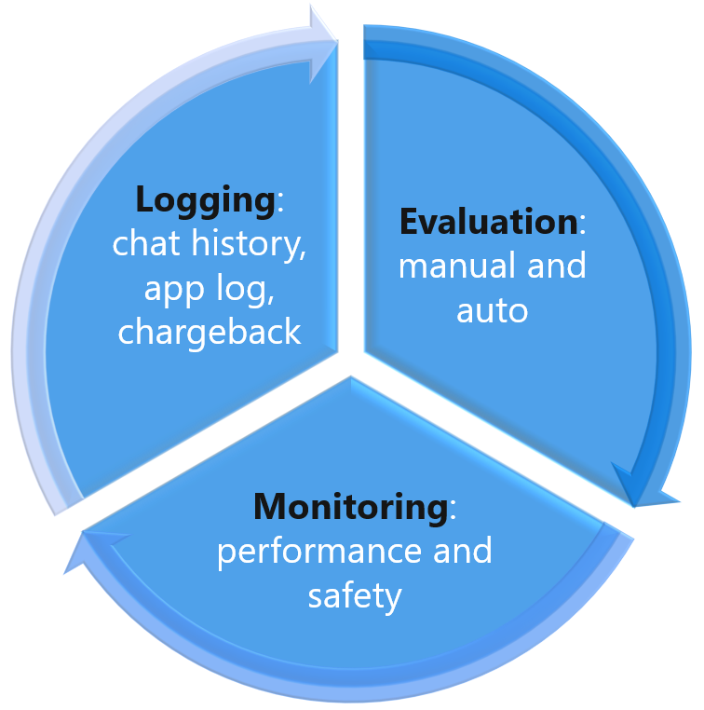
GenAI Ops

Slide 17
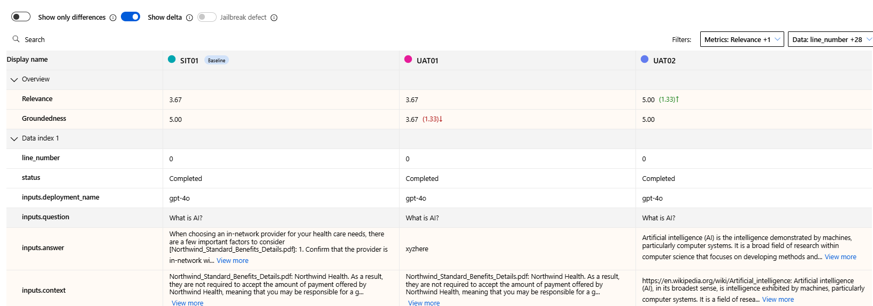
From feeling to number

Slide 18
Experience Sharing – the 5 Step
Drive test cases from requirement spec. (eg. 10 requirements)
Define max number of questions for each requirement. (e.g. 3 questions for each requirement, ie. 3 x 10 = 30). Prepare the test dataset.
Define the relevant metrics (e.g. groundedness, relevance, latency) and agree on the acceptance criteria. Enable tracing
Iteration: Execute the test cases, evaluate, analyse and keep track the metric
Continuous monitoring after golive

Slide 19
Announcing
Preview
Preview
o1-preview
o1-mini
Available in AI Studio and GitHub Models
https://aka.ms/new-models

Slide 20
Key Capabilities
Generating complex code
Problem-solving and brainstorming
Comparative analysis
Instruction following

Slide 21
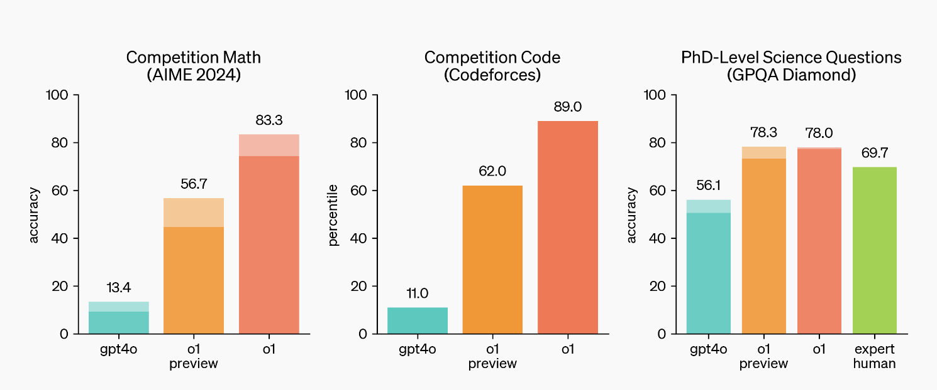

Slide 22
Model Guidance
o1-preview | Focused on advanced reasoning and solving complex problems, including math and science tasks.
o1-mini | Smaller, faster, and more cost-efficient version of o1-preview. Performs well at instruction following and small context operations.
GPT-4o | A versatile, multimodal model for text and image processing, non-English languages, and vision tasks.
GPT-4o-mini | A cost-effective version of GPT-4o for lightweight applications.

Slide 23
As of 15 Oct 2024
Azure OpenAI Service Offerings
Service
Azure OpenAI Service offerings
Offer type
Standard (PayGo)
Batch
Provisioned (PTUs)
Deployment type
Global
Regional
Global
Global
Regional
Global deployments leverage Azure's global infrastructure, dynamically route customer traffic to the data center with best availability for the customer’s inference requests.

Slide 24











Azure Data Capabilities
Data integration across Microsoft Cloud
6
7
8
9
10
Data modernization
Cloud native applications
Analytics and insights
Data science
Governance
Azure is the best destination for all your data
Ultra low latency at any scale globally
Fastest time to insights
Responsible, powerful AI on your terms
AI powered discovery,
catalogue, and protection
Common Data Model
6
6
6
Foundation - Enterprise grade security, high quality, discoverable data

Slide 25











Microsoft Intelligent Data Platform
Databases
• Analytics • AI • Governance
1
Azure SQL DB
Azure Cosmos DB
Azure for
PostgreSQL
MySQL
Microsoft Fabric
Azure Databricks
Azure AI
Microsoft Purview

Slide 26
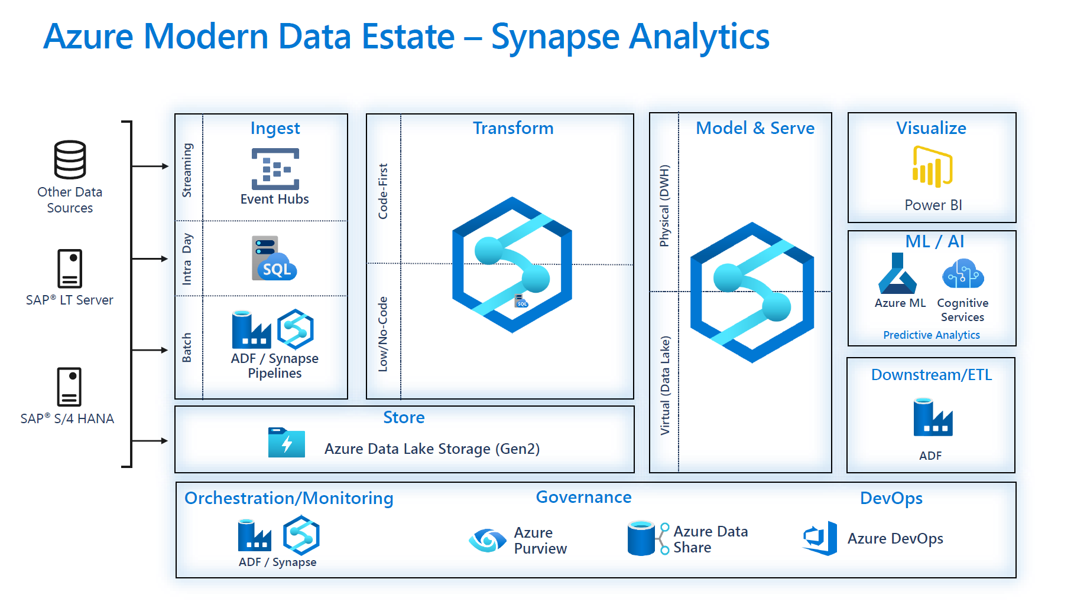

Traditional PAAS: The typical flow
Structured Data (on Prem/Cloud)
Unstructured Data (on Prem/Cloud)

Slide 27












Microsoft Fabric
Saas offer: The data platform for the era of AI
Data Factory
Data Engineering
Data Warehouse
Data Science
Real-Time Analytics
Partner & Industry workloads
Real-Time Intelligence
Power BI
Data Activator
Copilot in Fabric
OneLake
Microsoft Purview

Slide 28
Bring in data from anywhere
Fabric compute engines
Microsoft Fabric
Data
Factory
Data
Engineering
Data
Science
Data Warehousing
Real -Time Intelligence
Power BI
Partner & Industry workloads
Mirroring
Spark
T-SQL
Serverless Compute
KQL
Analysis Services
Azure COSMOS DB
Azure SQL DB
Mongo DB
More coming soon…
Customer 360
Finance
OneLake
Service Telemetry
Business KPIs
Add or manage data from your cloud data warehouses and databases
Dataverse
Google
Amazon
Azure
Multi-cloud shortcuts
Virtualize data in OneLake from Azure, Dataverse, Google, and Amazon S3 without moving or duplicating it
*Note: refer to seller guidance and present this section to Microsoft/Fabric users

Slide 29

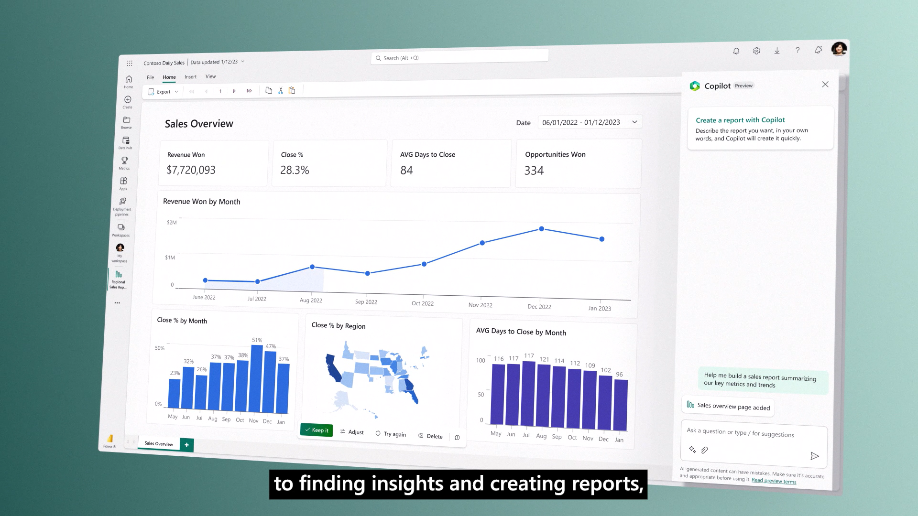
Copilot in Fabric

Slide 30

Azure AI + Microsoft Fabric = boundless possibilities
Enhance data insights
Build enterprise chat applications to uncover insights using natural language from structured, unstructured, and real-time data
Ground your AI on unstructured data
Ensure your AI is using the latest data in its interactions with your employees, partners, and customers
Azure AI Studio
Microsoft Fabric
Your gateway to AI apps and custom copilot experiences
Analyze customer interactions
Build speech analytics applications to enhance customer service, tailor support responses, and make data-driven decisions
Your unified solution for analytics
Customize machine learning models
Train, deploy, and orchestrate machine learning models tailored to specific business needs––from predictive maintenance to customer sentiment analysis
OneLake serves as the connective tissue to build generative AI apps powered by your data

Slide 31







Azure AI + Microsoft Fabric
Microsoft Fabric
Azure AI Studio
OneLake
4
Query for Embedding
1
Indexing
Ada-002 (Embedding)
Embedded query
5
3
2
Customer data
Query
Query
Azure AI Search (vector-index)
Azure Function
9
Answer
Web App
10
Answer
User
Parquet files
6
Search result
Notebook
7
Response stored in parquet files
8
Response
GPT-4 Turbo (Text generation)
Power BI
Delta tables
Prompt Flow
11
Delta table data
Fabric processes
Azure AI Studio processes
Other processes

Slide 32




















End-to-end Cloud Native path
Community
Security
AI
Microsoft Entra ID
Azure Policy
Microsoft Defender
AI Services
OpenAI
Machine Learning
Development tools
Platform
Managed databases
Storage
GitHub
Azure MySQL & MariaDB
Azure Kubernetes Service
Azure Kubernetes Fleet Manager
Azure PostgreSQL
Azure Cosmos DB
Azure SQL family
Azure Storage
Visual Studio Code
Azure API Management
Cloud operations anywhere
Azure Container Registry
Azure Arc

Slide 33
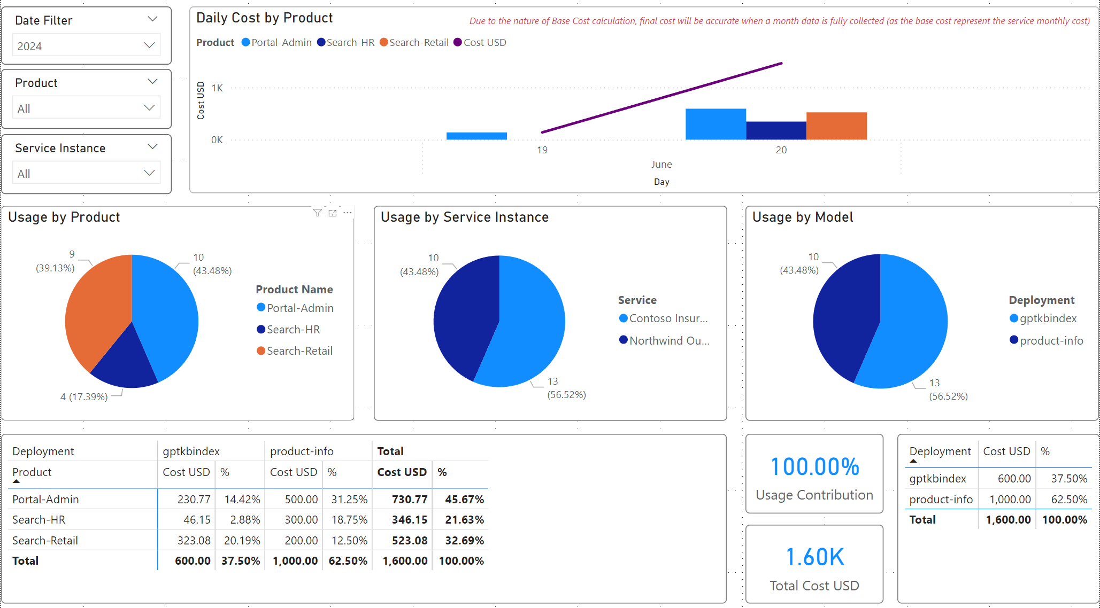
Calculating Chargeback for BU/Projects
https://github.com/Azure-Samples/ai-hub-gateway-solution-accelerator

